Slide 1
NEA Julkarameller 2014!

Slide 2
NEA – Nätverket för Elektroniska Affärer
Christer Rygaard
Christer.rygaard@nea.nu

Slide 3
Kort om NEA
Vi är en ideell medlemsstyrd intresseorganisation utan vinstintresse.
Vi verkar för att e-affärer ska vara en självklarhet inom alla företag, organisationer och i samhället i stort.
NEA erbjuder en neutral och oberoende mötesplats för alla som är intresserade av eller verksamma inom e-affärer.

Slide 4
Vi är NEA:
Advokatfirman Delphi i Sthlm AB
Affärsbankernas Service AB
Bankgirocentralen BGC AB
Basware AB
Compello AB
CGI
Data Interchange AB
Danske Bank
eBuilder Sweden AB
EDI Solutions AB
Ekonomistyrningsverket
Ericsson AB
EVRY AB
Fortnox AB
Fredholm Consulting AB
GS1 Sweden AB
Hogia Business Products AB
iCore Solutions AB
InExchange
IT- & Telekomföretagen
Kelisec AB
Know e AB
Kommerskollegium
Logiq AS
LRD Revision och Rådgivning
Nordea Bank AB
MIO
Opus Capita
Palette
ReadSoft AB
Scancloud
SEB
Strålfors Svenska AB
Swedbank
Sveriges kommuner och landsting
Symbrio AB
Telge Kraft AB
Tickstar AB
Tieto Value Networks
TrustWeaver AB
UNIT 4 Agresso AB
Vattenfall AB
Visma Commerce AB
Visma SPCS AB

Slide 5
NEAs arbetsgrupper
Nationellt e-fakturaforum – speglingsgrupp till EUs European Multi Stakeholder Forum on Electronic Invoicing (EMSF)
Juridik och Säkerhet
Handel och Logistik
Operatörssamverkan
Programrådet

Slide 6
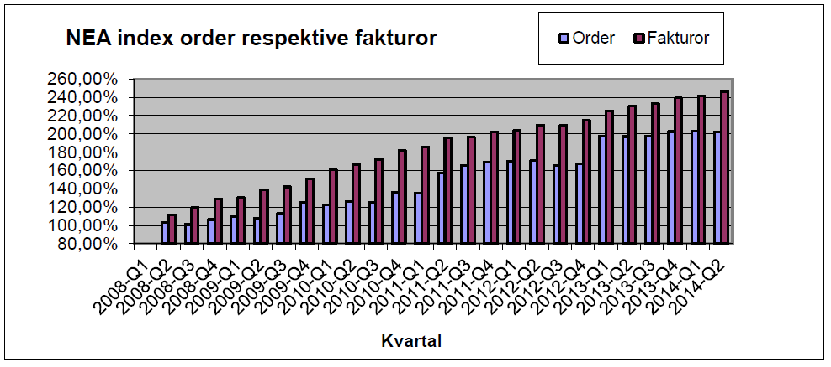
NEA Index

Slide 7
Development of E-Invoicing Market Penetration
Notes:
Thank’s Andrew
Hello everybody
For most people, invoice processing sounds like a bit of boring back office work. Therefore am I very pleased that you are different and that you show interest for the webinar about paperless invoice processing.
E-Invoicing is a passion for me and I spend already 17 years of my professional career in this field.
Invoices are key everywhere on our world.
I collect invoicing data worldwide and come to the conclusion, that the annual volume is at least 500 billion, 170 billion of it in the segment business-to-business and business-to-government.
Almost everywhere on the world are organizations in progress to replace paper invoices by electronic ones.
Although the adoption rate has achieved just around 8%, is the electronic substitution of paper invoices rapidly developing.
The annual volume increase in electronic bills and invoices is estimated to be at 20%.
Such high growth rates can be expected to stay sustainable for the coming years, as e-invoicing is pushed by the private industry but also by the public sector.

Slide 8
International E-Invoicing Adoption B2B, B2G, G2B and B2C
Leaders
Average
Developing
Laggards
Source: Billentis, 2014
Notes:
Some countries in Latin America and Europe are the most advanced regarding adoption rate of e-invoices.
Quite often are the most advanced countries in Europe obliging businesses to send the invoices to the public sector just in electronic format.
An increasing number of Latin American countries goes one step beyond this and oblige the businesses to send e-invoices to the public sector, but also to other businesses.
This is especially the case in Brazil, where currently every month around 1 billion invoices are echanged electronically.

